Slide 1


EVALUATION OF DEEP LEARNING TECHNIQUES IN SENTIMENT ANALYSIS FROM TWITTER DATA
Sani Kamış
Yeditepe University
Istanbul, Turkey
Dionysis Goularas
Yeditepe University
Istanbul, Turkey
PRIYANKA HOTCHANDANI, COMPS B3, 1911106

Slide 2

INTRODUCTION

Slide 3
INTRODUCTION
Process of categorizing opinions from piece of text, to determine and classify the writer's attitude towards a particular topic or product.
Numerous approaches used, based on NLP and ML techniques for extracting adequate features and classifying text in appropriate polarity labels
CNN and LSTM networks proved to be performant for sentiment analysis tasks
Word2Vec and GloVe methods used for feature extraction from words

Slide 4
INTRODUCTION
Sentiment analysis is still an ongoing and open research subject
Researchers are trying to develop new methods or improve the present ones as existing methods have variety in terms of network configuration, tuning, etc.
Paper contributes by evaluating the most popular deep learning methods and configurations based on an approved dataset about sentiment analysis
Dataset is created from Twitter data under a single testing framework

Slide 5

METHODOLOGY
Dataset and preprocessing
Word embedding
Neural networks

Slide 6

DATASET AND PREPROCESSING
The SemEval2014 Task9-SubTask B full data, the SemEval2016 full data Task4 and the SemEval2017 development data were used forming a total of around 32.000 tweets
Consisted of a body of 662.000 words with a vocabulary of around 10.000 words
Conversion of all letters to lowercase, the removal of some special characters and emoticons or the tagging of urls

Slide 7

WORD EMBEDDING
Word2Vec: Create 25-dimensional word vectors based on the dataset and discard the words that appear less than five times. Set the maximum skip length between words to 5
GloVe: 25-dimensional vectors created from 2 billion tweets, which constitutes a significantly larger training dataset than the dataset extracted from SemVal data

Slide 8
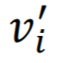
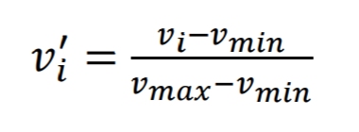
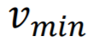
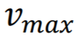
WORD EMBEDDING
All vectors were normalized using the following equation:
: is the normalized i-value of a 25-dimensional vector
: is the minimum value of the vector
: is the maximum value of the vector

Slide 9
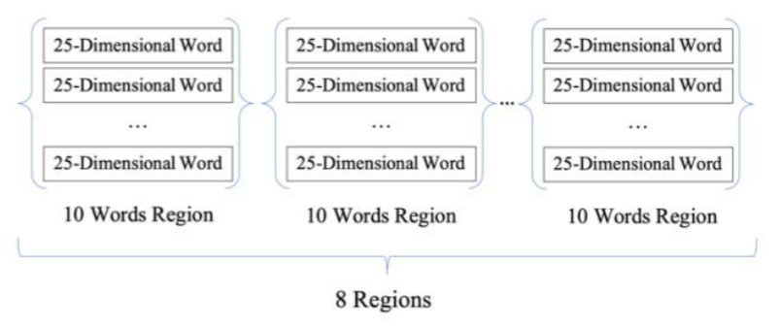
WORD EMBEDDING
Sentence Regions
Divide the word vectors of a sentence in regions using the punctuation marks
Doing so preserves information in a sentence
Every sentence has 8 regions, and every region has 10 25-dimensional words
Sentence Vectors
Concatenate the word vectors of a tweet in order to form a unique vector
Remove extra words when tweets vary in length
Use zero padding in order to fill the missing words in a sentence
Converted dataset: non-regional having input size 1000, regional based sentences having input size 2000

Slide 10

NEURAL NETWORKS
Proposed neural network configurations are based on CNN and LSTM networks
All the networks were tested with both non-regional and regional datasets
All networks were trained with 300 epochs and used sigmoid activation function

Slide 11
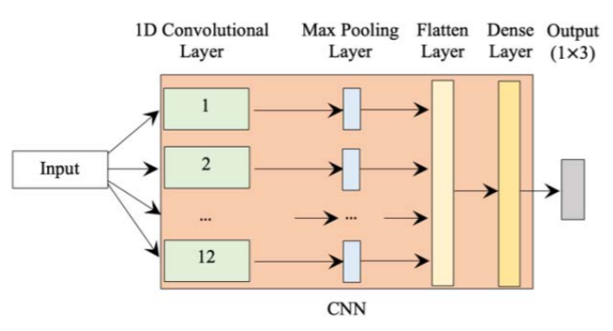
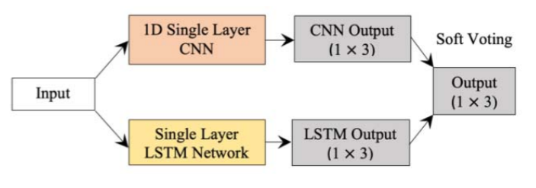
NEURAL NETWORKS
Single CNN Network
Single LSTM Network
Individual CNN and LSTM Networks

Slide 12
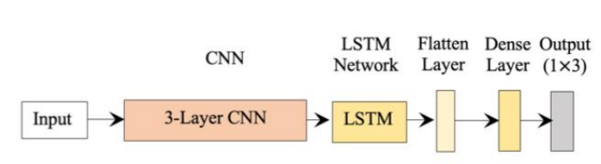
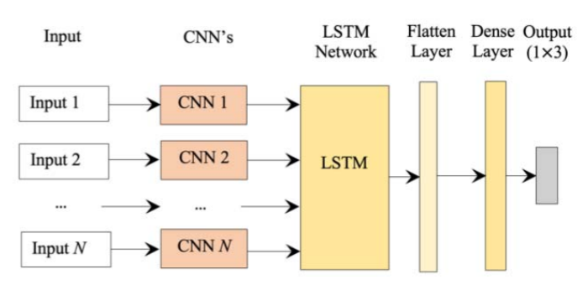
NEURAL NETWORKS
Single 3-Layer CNN and LSTM Networks
Multiple CNN's and LSTM Networks
Single 3-Layer CNN and bidirectional LSTM Network
Multiple CNN's and bidirectional LSTM Network

Slide 13

RESULTS

Slide 14
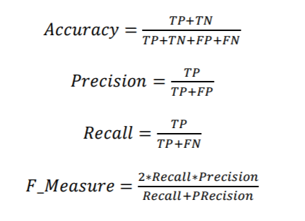
RESULTS
Performance results of the previous network configurations in terms of Accuracy, Precision Recall, and F-measure (F1) as described in the following equations:
TP - True Positive Predictions
TN - True Negative Predictions
FP - False Positive Predictions
FN - False Negative Predictions

Slide 15
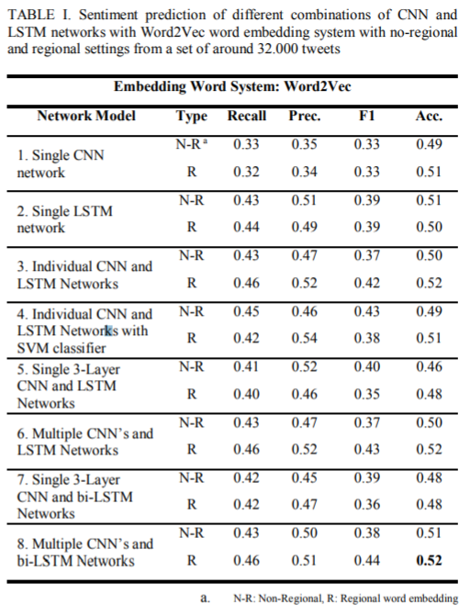
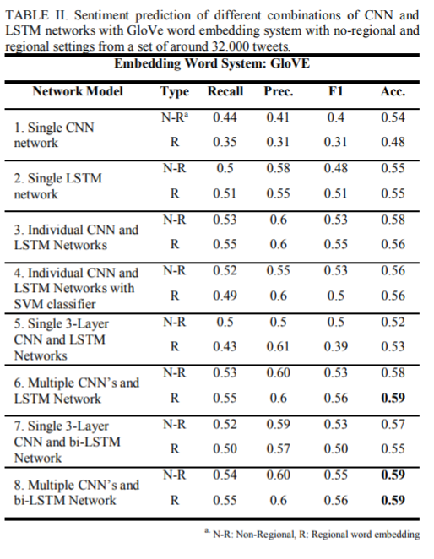
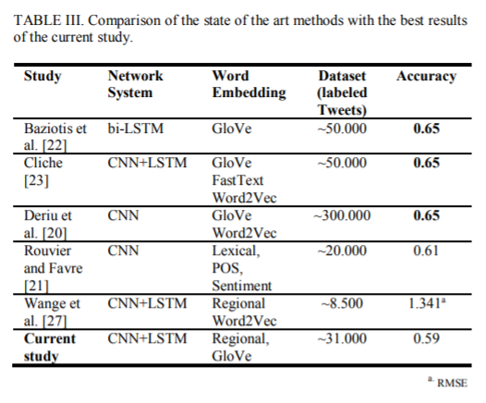
RESULTS

Slide 16
RESULTS
Observations:
Utilizing the GloVe system increased the performance of almost all configurations by 5%-7%
Using multiple CNN with LSTM networks instead of simple configurations increases the performance of the system, independently of the word embedding system by 3%-6%
Separating the text input into regions in most cases doesn’t really improve the performance of a configuration
Use of bidirectional LSTM networks instead of simple LSTM networks doesn’t present any real advantage

Slide 17

CONCLUSION
Deep Learning methods along with word embedding systems tested for sentiment analysis in Twitter data
Evaluation gave slightly inferior results (65% accuracy)
Proved that having an appropriate dataset is the key element for increasing the performance
Showed the limitations of CNN and LSTM networks on the field

Slide 18

STRATEGY FOR IMPLEMENTATION
Implement Word2Vec model, which is one of the two word embedding models talked about in the paper
Implementation of Label encoder used to classify text into 'POSITIVE', 'NEGATIVE', 'NEUTRAL'
Kaggle Dataset to be used: Sentiment140 dataset with 1.6 million tweets

Slide 19



References
Link to the research paper: https://ieeexplore.ieee.org/document/8876896
Few references from the paper:
[1] L. L. Bo Pang, «Opinion Mining and Sentiment Analysis Bo», Found. Trends® Inf. Retr., vol. 1, no. 2, pp. 91–231, 2008.
[2] K. Fukushima, «Neocognition: A Self-organizing Neural Network Model for a Mechanism of Pattern Recognition Unaffected by Shift in Position», Biol. Cybern., vol. 202, no. 36, pp. 193–202, 1980.
.
.
.
[27]J. Wang, L.-C. Yu, K. R. Lai, eta X. Zhang, «Dimensional Sentiment Analysis Using a Regional CNN-LSTM Model», Proc. 54th Annu. Meet. Assoc. Comput. Linguist. (Volume 2 Short Pap., Vol 2, pp. 225– 230, 2016.

Slide 20

THANK YOU!

